Slide 1
Goals this Week
1. Understand how to use for loops
2. Continue working on the first PHP exercise
3. Start your first PHP assignment

Slide 2
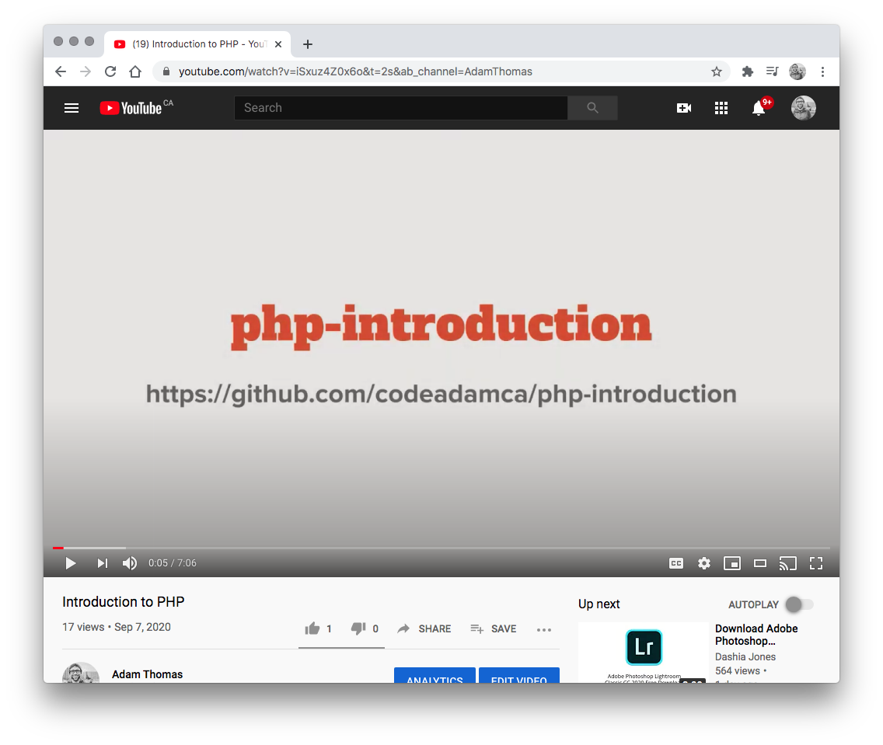

1. YouTube Videos
Watch the Following Youtube Videos:
PHP For Loops https://www.youtube.com/watch?v=uZ7mq8Yjj3o

Slide 3
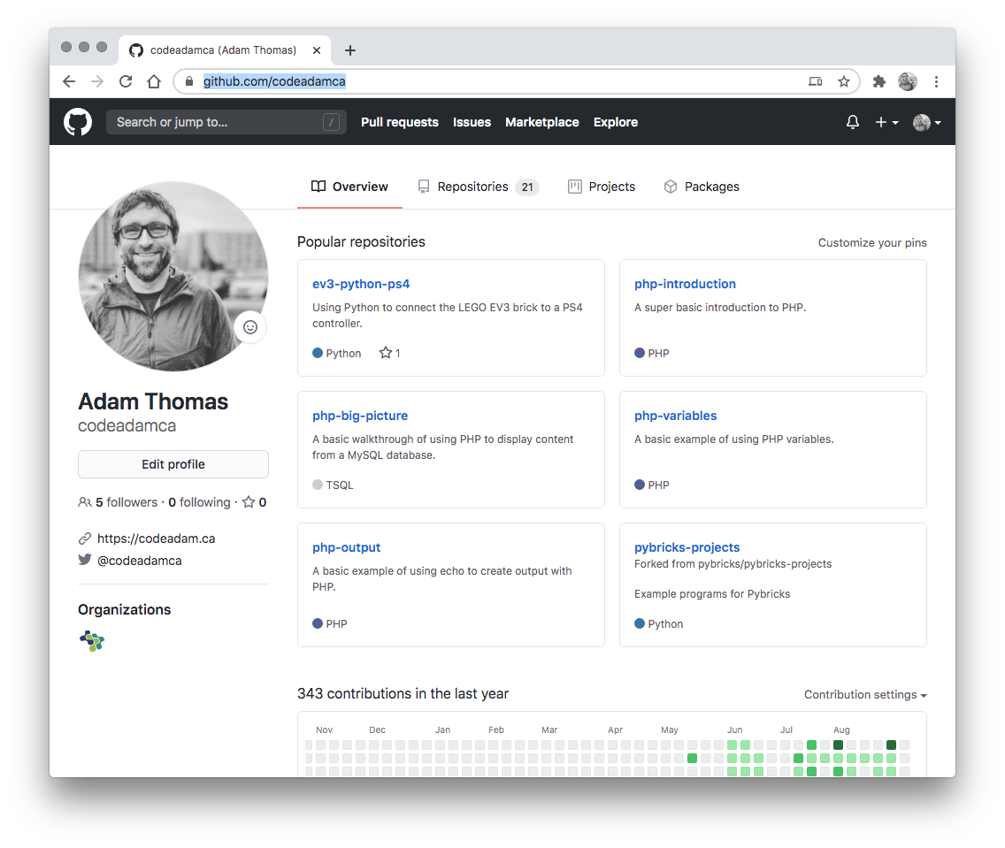

2. Review Code
Review the provided code and follow along with any coding instructions in GitHub:
PHP For and While https://github.com/codeadamca/php-for-while

Slide 4
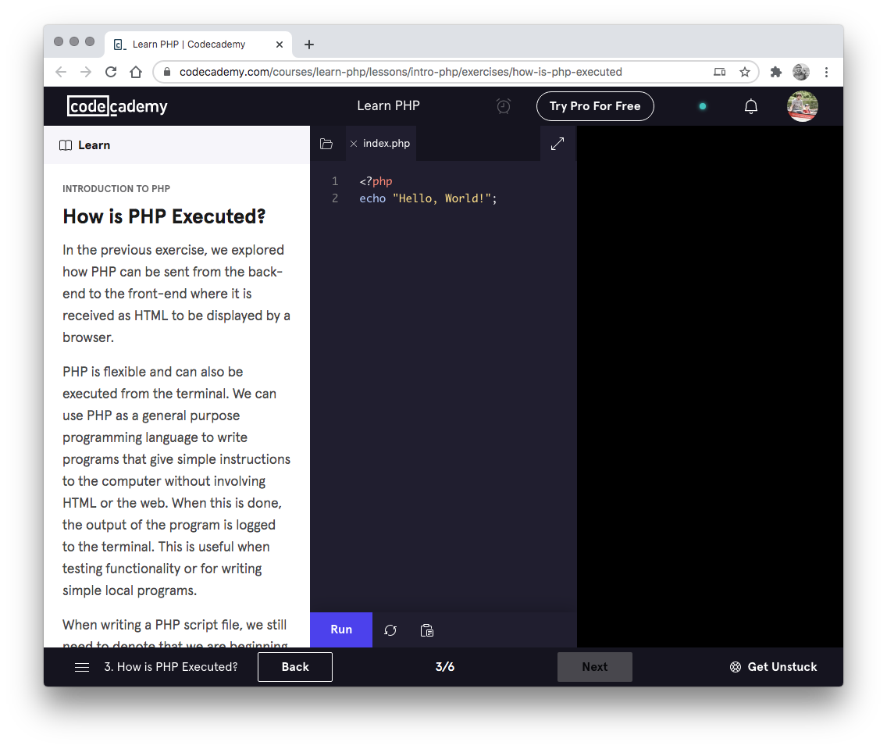

3. Codecademy
Complete the following Codecademy exercises:
PHP Loops: https://www.codecademy.com/learn/learn-php-arrays-and-loops

Slide 5
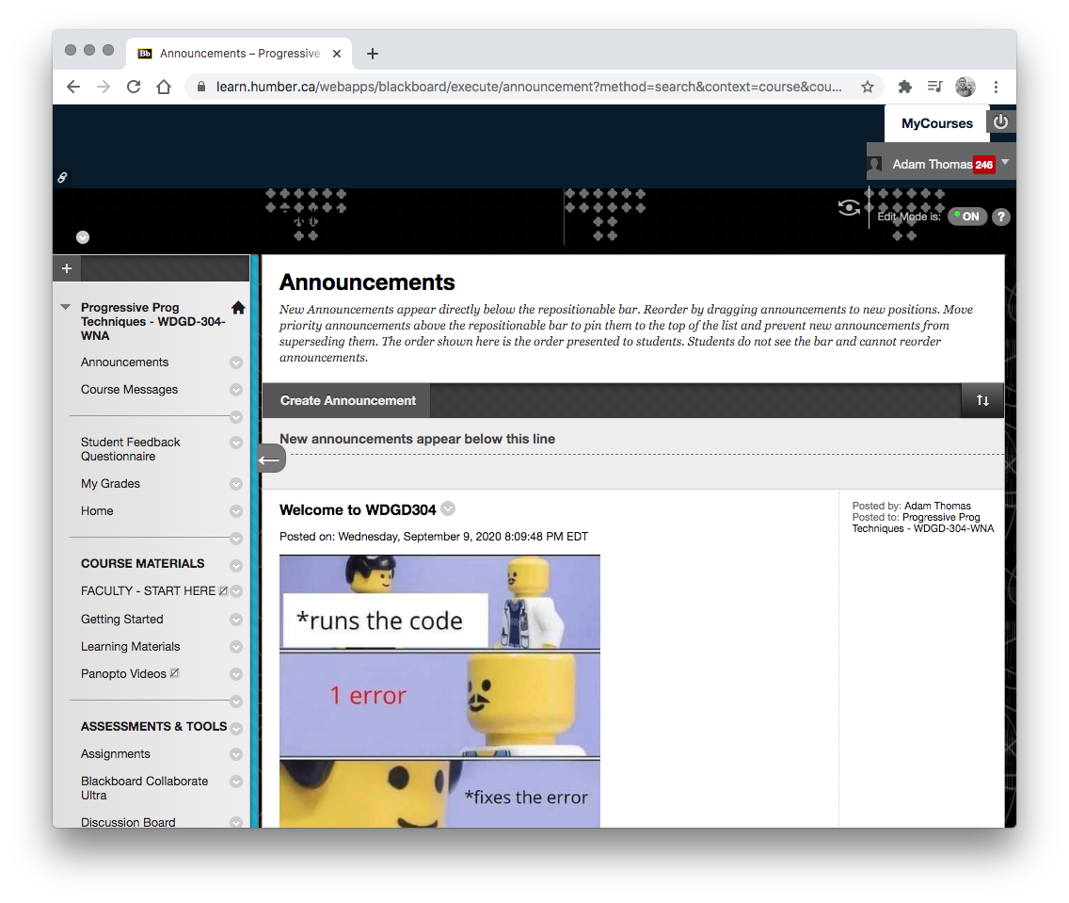
4. Exercises
Keep working on your first exercise.
Complete your first PHP exercise.

Slide 6
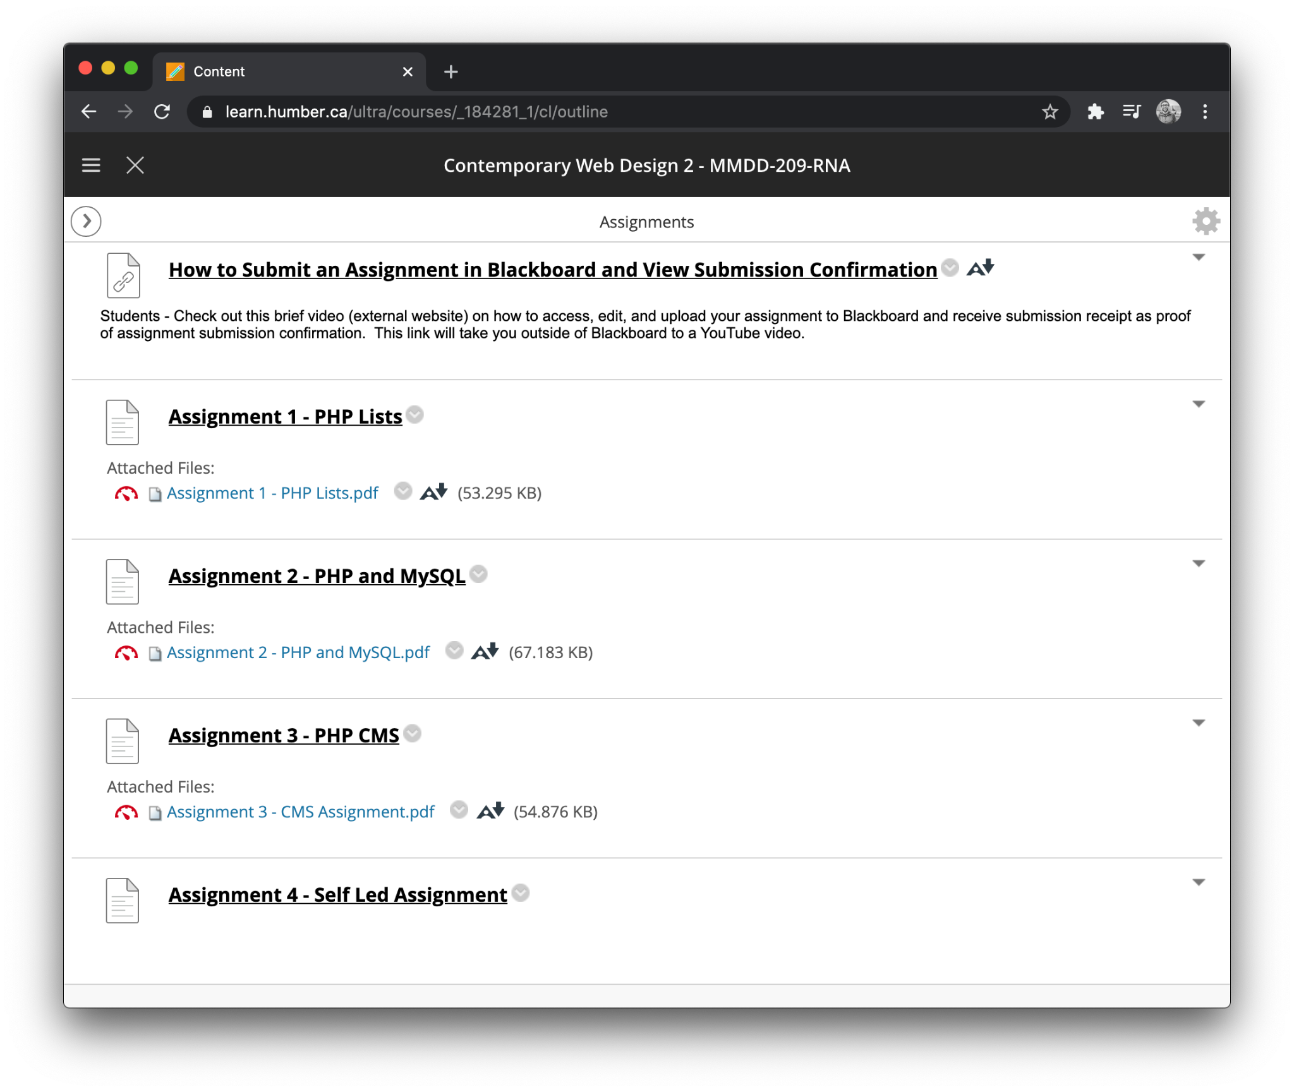
5. Assignments
Start your first PHP assignment.
Your first PHP assignment requires data, loops, and arrays. Review the assignment PDF and start gathering your data.

